Slide 1
Low-Bandwidth Three Dimensional Mapping and Latency Reducing Model Prediction to Improve Teleoperation of Robotic Vehicles
William Woodall wjwwood@gmail.com
w@auburn.edu
Notes:
Last presentation 24min., make it shorter…

Slide 2
Overview
Motivation & Previous Work
Three Dimensional Mapping
Teleoperation
Latency Reduction
Test Hardware and Software
Latency Reduction Trials
Conclusions, Contributions, & Future Work

Slide 3
Motivation
Improve teleoperation of UGV’s
Networks have:
Low bandwidth
High latency
Three dimensional data:
Useful for obstacle avoidance
Requires a lot of processing and bandwidth
Traditionally requires expensive sensors

Slide 4
Motivation
RGB-D Sensors:
Microsoft Kinect
ASUS Xtion Live Pro
Data represented as point clouds
Does not work in daylight
Other three dimensional sensors:
Rotating/Spinning LiDAR
Stereovision

Slide 5
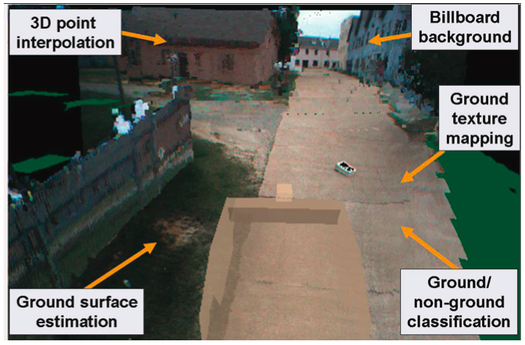
Previous Work
D. Huber, H. Herman, A. Kelly, P. Rander, and J. Ziglar, “Real-time photo-realistic visualization of 3d environments for enhanced tele-operation of vehicles,” in Computer Vision Workshops (ICCV Workshops), 2009 IEEE 12th International Conference on, 27 2009-oct. 4 2009, pp. 1518 –1525.

Slide 6
Previous Work
The CMU work showed:
Three dimensional information is useful
Latency greatly effects teleoperator’s ability to control the robotic vehicle
But Neglected:
Bandwidth usage
Processing requirements
Latency reduction

Slide 7
Previous Work
Octomap
Provides octree data structure
Probabilistic insertion of point clouds
PCL
Down-sampling
Filtering
Transformation

Slide 8
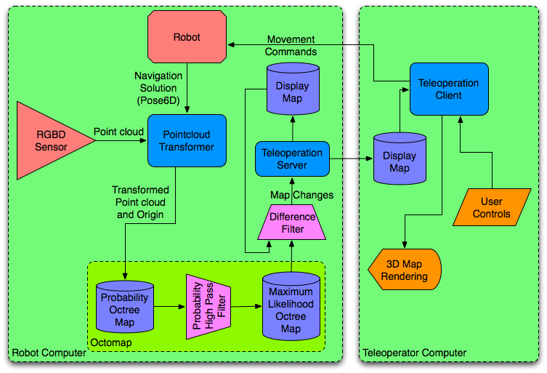
System Design

Slide 9
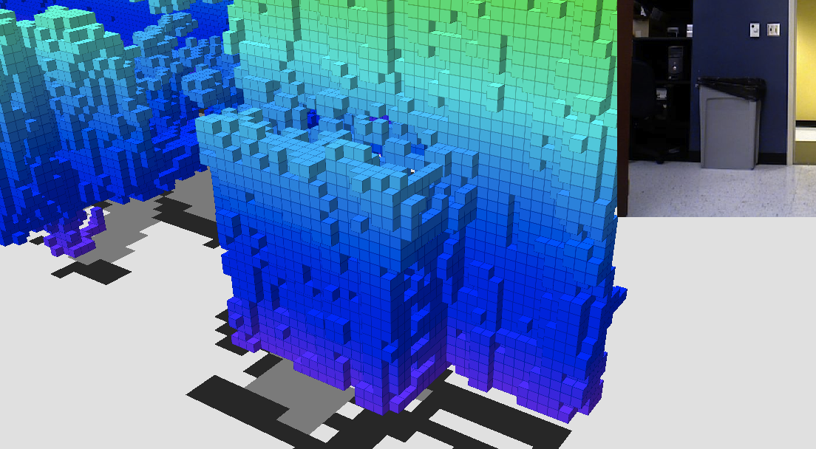
Three Dimensional Mapping

Slide 10
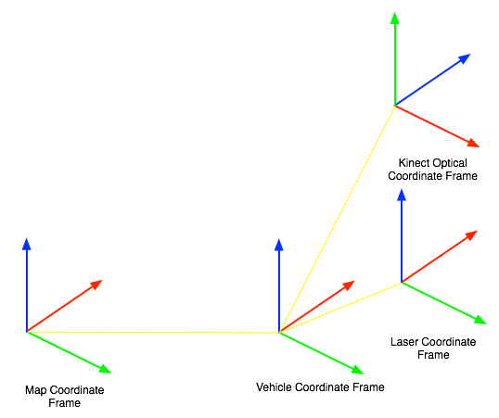
Point Cloud Transformation
Use the vehicle’s navigation solution to transform the point cloud data from the Kinect into the map coordinate frame

Slide 11
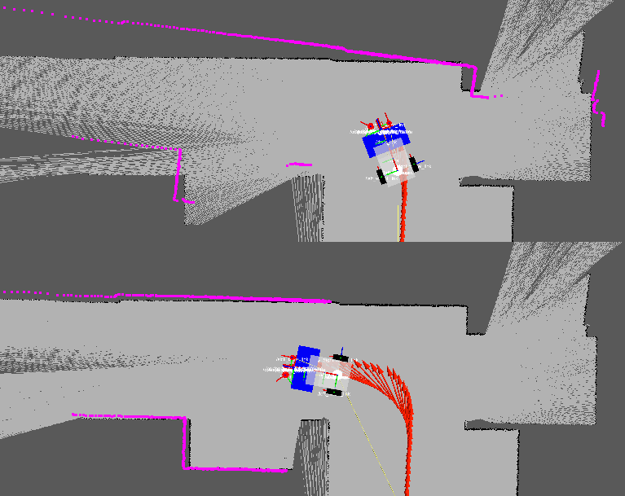
Dealing with Navigation Error
Sources of navigation error:
Estimation drift from dead reckoning
Opportunistic point cloud insertion
Insert data right after measurement update, during lowest pose uncertainty

Slide 12
OctoMap Insertion
Insert the transformed point cloud
Ray trace the voxel grid from the sensor origin to each point in the point cloud
For each voxel the ray trace passes through, decrease the probability of occupancy
For each voxel the ray trace ends in, increase the probability of occupancy
Produce a maximum likelihood map
Use a probability threshold to get the state (occupied, unoccupied, or unknown) for each leaf of the octree

Slide 13
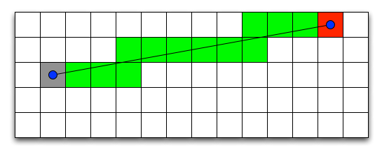
Dealing with Kinect Error
Types of Kinect error:
Depth measurement discretization
Point density drops over distance
Random error in depth measurement

Slide 14
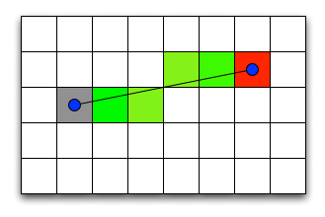
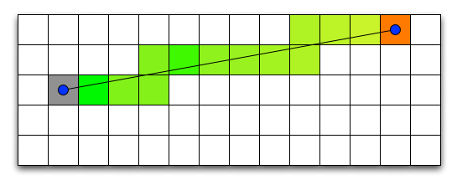
Dealing with Kinect Error
Varying hit and miss values
Quadratic
Linear
Short ray
Long ray

Slide 15
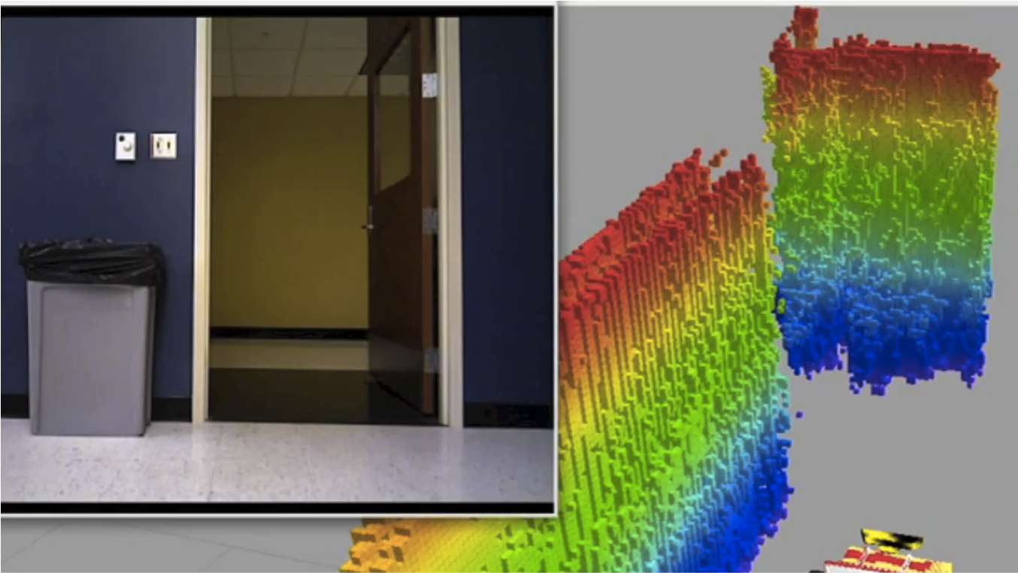
Three Dimensional Mapping

Slide 16
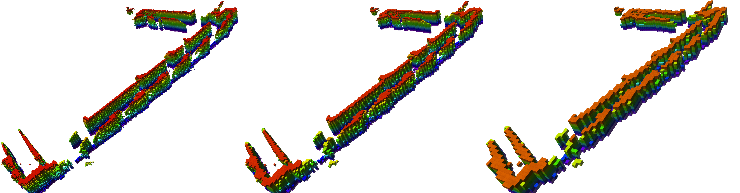
Benefit of Octree Data Structure
Compact, concise map representation
Varying query depth allows for efficient down-sampling
0.1m
0.2m
0.4m

Slide 17
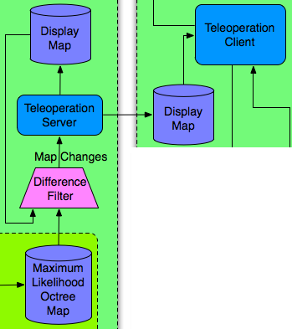
Robot-Teleoperator Map Sync.
Difference the maximum likelihood map with the client map
Sync some portion of those differences with the client map based on estimated bandwidth

Slide 18
Teleoperation Bandwidth

Slide 19
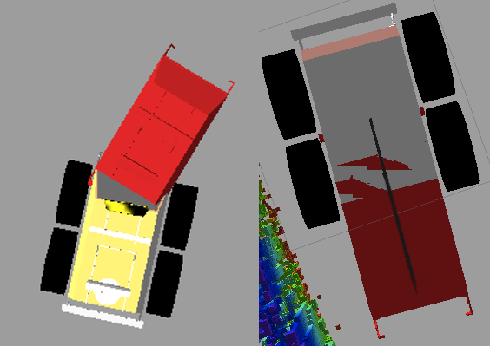
Latency Reduction
Goal: Use a model of the robotic vehicle to predict the motion of the vehicle based on user input

Slide 20
Latency Reduction
Collect teleoperator input
Periodically run a simulation of the vehicle
Use latest vehicle pose as initial conditions
Step the simulation at a standard period
At each step use the most recent user input
Run until simulation time is at real-time

Slide 21
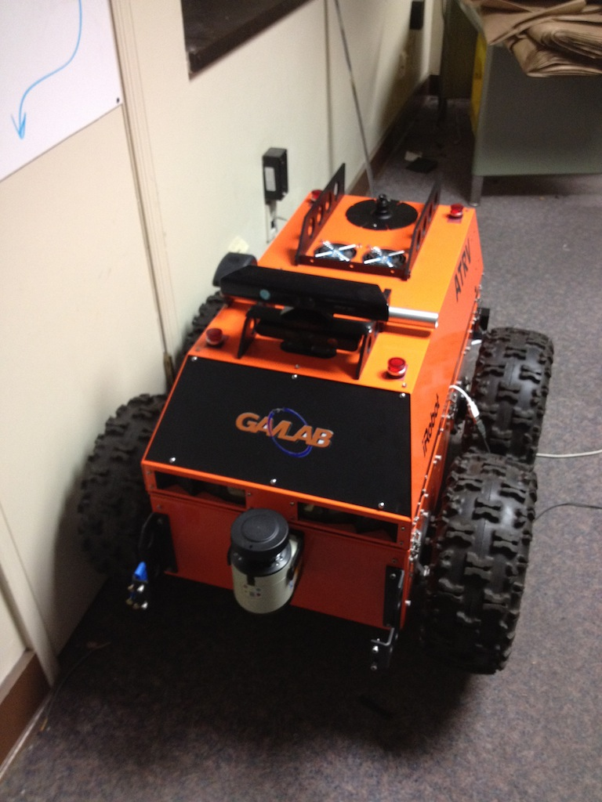
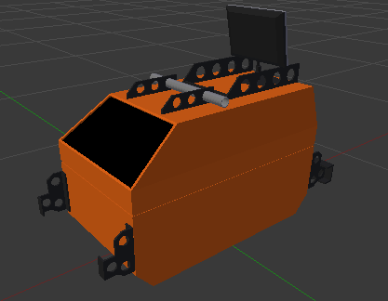
Test Hardware
iRobot ATRV
ASUS Xtion Pro Live
Sick LMS151 LiDAR

Slide 22


Test Software
Octomap
PCL
ROS
Visualization done with rviz
Programming:
C++
Python

Slide 23
Latency Reduction Trials
Camera:
0s RTT
1s RTT
2s RTT
Camera + 3D:
0s RTT
1s RTT
2s RTT
Camera + 3D + Prediction:
1s RTT
2s RTT

Slide 24
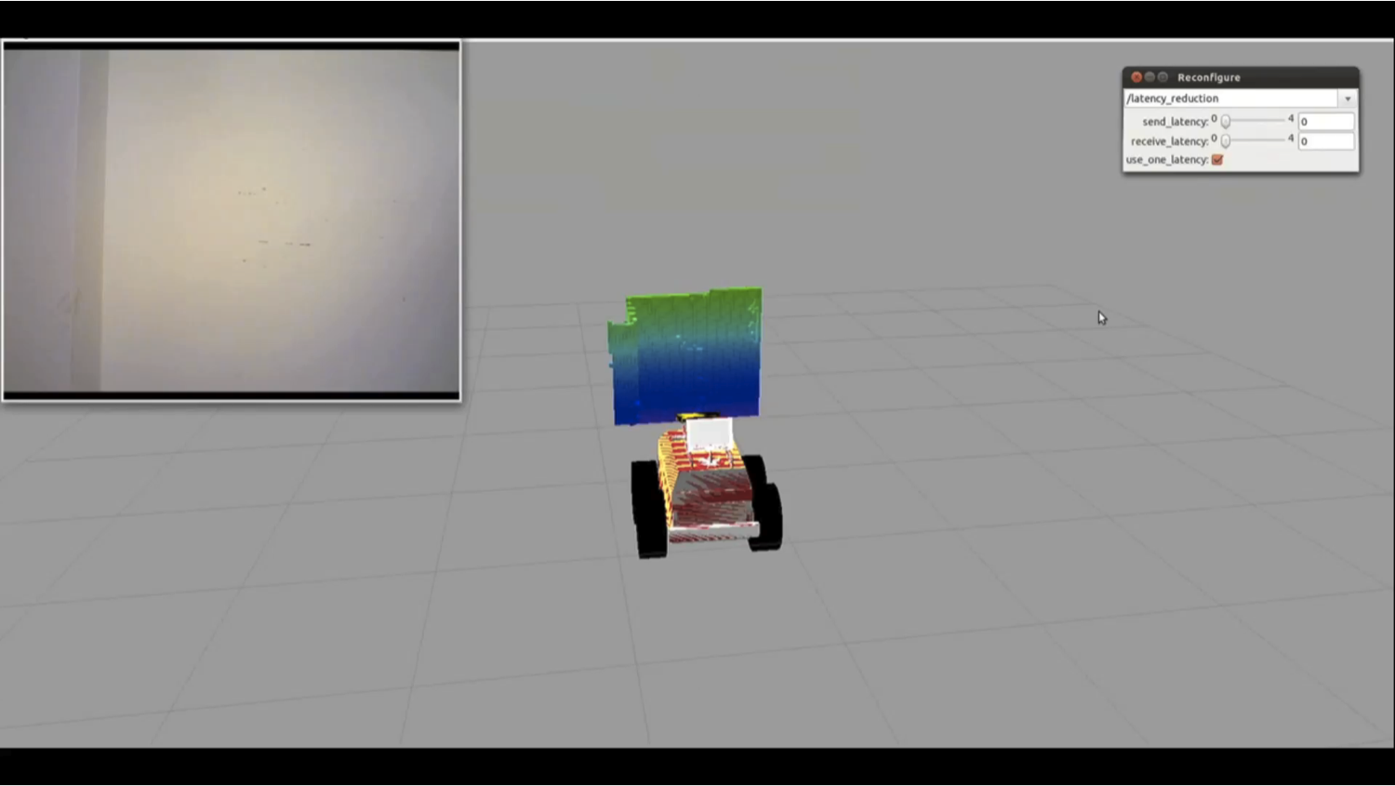
Latency Reduction Trials

Slide 25
Latency Reduction Trial Times

Slide 26
Latency Reduction Trial Hits

Slide 27
Conclusions
Mapping:
Sensitive to navigation errors
Processing is relatively efficient
Should scale to larger, outdoor platforms
Teleoperation
Octree is an optimal data structure
Low bandwidth is possible
Three dimensional data improves teleoperation in the presence of latency

Slide 28
Conclusions
Latency Reduction
Effectiveness is inconclusive
Seems to help with obstacle avoidance in the presence of latency

Slide 29
Future Work
Improved Mapping
KinectFusion
Outdoor Vehicle
Non-flat terrain
Dynamic vehicle model
More Latency Reduction Trials
More teleoperators
More runs per teleoperator
No camera scenario

